Slide 1

Ancient Indian WATER MANAGEMENT
Sourabh Sharma – Csbs -AC1
RA2111042010007

Slide 2

NATURAL FORM OF IRRIGATION
The earliest form of irrigation probably involved people carrying buckets of water from wells or rivers to pour on their crops. As better techniques developed, societies in Egypt and China built irrigation canals, dams, dikes, and water storage facilities.
Traditional water reservoirs, such as step-wells, known as ‘bawlis’, were being used to ease water challenges in India. The ‘bawli’ fills up with rainfall and via water drawn up from below ground. The tanks were traditionally used to store water for drinking, bathing and farming.

Slide 3
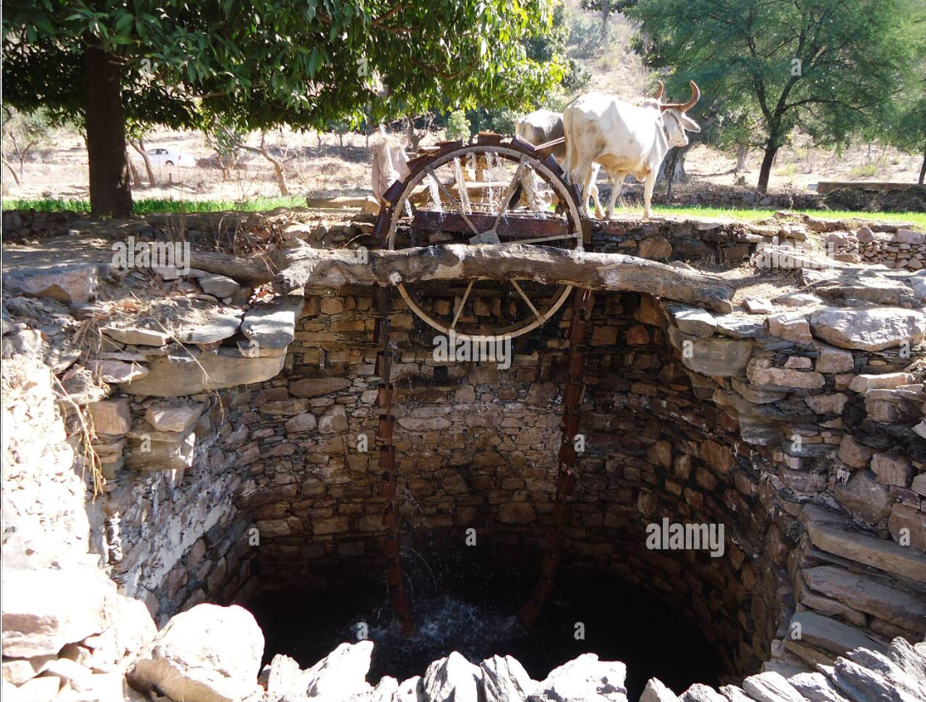
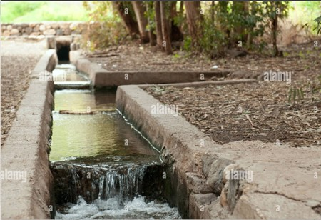
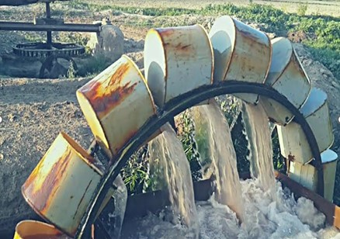
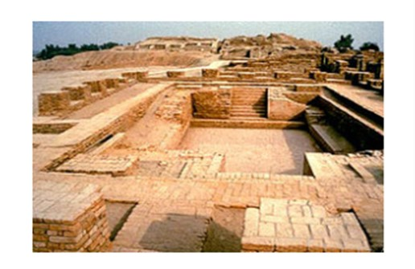
ANCIENT INDIA

Slide 4

ANCIENT INDIA
The earliest mentions of irrigation are found in Rigveda chapters.
The Veda mentions only well-style irrigation, where kupa and avata wells once dug are stated to be always full of water, from which varatra (rope strap) and cakra (wheel) pull kosa (pails) of water.
This water was, state the Vedas, led into surmi susira (broad channels) and from there into khanitrima (diverting channels) into fields.
Later, the Indian scholar Pāṇini, mentions tapping several rivers for irrigation.
Buddhist texts from the 3rd century BCE also mention irrigation of crops.
Texts from the Maurya Empire era (3rd century BCE) mention that the state raised revenue from charging farmers for irrigation services from rivers.
Patanjali, in Yogasutra of about the 4th century CE, explains a technique of yoga by comparing it to "the way a farmer diverts a stream from an irrigation canal for irrigation".
Perennial irrigation was practiced in the Mesopotamian plain whereby crops were regularly watered throughout the growing season by coaxing water through a matrix of small channels formed in the field.

Slide 5
MEDIEVAL INDIA
The most widespread irrigation system in India was undertaken in India in the medieval period by the Sultanate rulers.
Firoz Shah Tughlaq (1309-1388) built the most extensive canal irrigation system around the Indo-Gangetic doab and the region west of the river Yamuna in the fourteenth century.
These canals provided vast resources of water to agricultural lands in northern India as well as vital supplies of water to urban and rural settlements.
These irrigation projects were continued by the subsequent rulers of northern India, particularly the Mughal rulers till the early eighteenth century.
The British built the colonial canal networks on these medieval canal systems.

Slide 6


Thank you

